Slide 1
Heredity Biotechnology and genetic techniques
Edited by Ms Rayner 2022

Slide 2
Syllabus:
Recombinant DNA technology and DNA identification technologies are applied in agriculture and environmental conservation
Identify & describe techniques that can be used in DNA identification and how these technologies can be applied in agriculture and environmental conservation
Essential
Question:

Slide 3
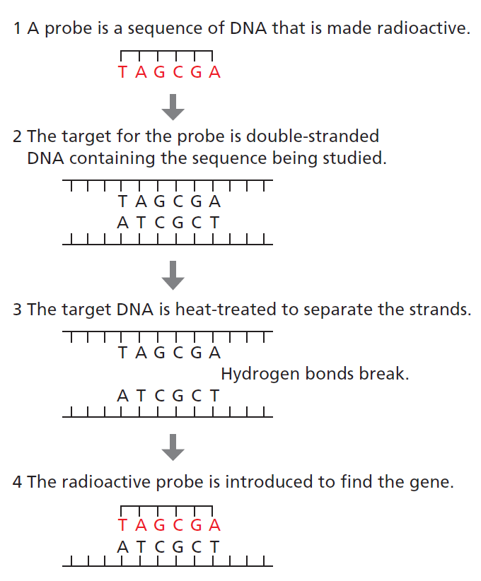
Genetic engineering techniques
Topic Question 1: Describe how a gene probe can be used to identify DNA ​
Gene probes can be used to search for a specific, small DNA sequence, such as the mutated allele that confers Huntington’s disease.
LISTEN:
https://www.genome.gov/genetics-glossary/Probe
Figure 5.10
Notes:
(To look for a larger sequence you would perform PCR, using primers as probes)
A gene probe (nucleic acid probe) is a single-stranded nucleic acid fragment that interacts with a complementary sequence of a target nucleic acid. The test is based upon the principles of nucleic acid hybridization reactions. Different assay formats (dot-blot, colony, whole-cell hybridizations) can be applied.
Hybridization is the process of combining two complementary single-stranded DNA or RNA molecules and allowing them to form a single double-stranded molecule through base pairing.

Slide 4
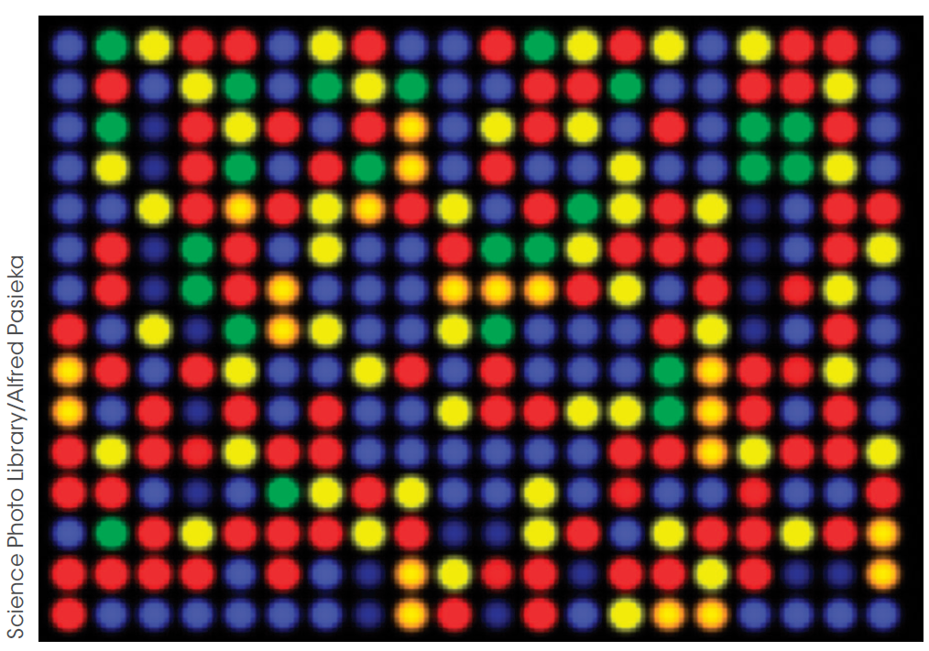
Genetic engineering techniques
Topic Question 2: Describe how a gene probe can be used to create a microarray ​
A microarray of a collection of gene probes attached to a solid surface (a glass microscope slide or a silicon chip – shown in the figure)
A microarray is a laboratory tool used to detect the expression of thousands of genes at the same time
https://www.genome.gov/about-genomics/fact-sheets/DNA-Microarray-Technology
Figure 5.11
Notes:
Green dots mean that the sample labeled green expresses that mRNA. Red dots mean the mRNA is only expressed in the other sample. Yellow dots mean both samples express the mRNA and blue or black dots mean neither expresses it.
The DNA microarray is a tool used to determine whether the DNA from a particular individual contains a mutation in genes.

Slide 5
Genetic engineering techniques
Topic Question 3: Describe the purpose of a microarray ​
In this figure, a DNA microarray is shown.
Microarrays measure the level of gene expression in a sample of DNA
Can screen a large number of genes at the same time
Identify genes that are being expressed in certain individuals & shows those genes not being expressed for comparison
Watch: https://www.youtube.com/watch?v=NgRfc6atXQ8
Figure 5.11
Notes:
Green dots mean that the sample labeled green expresses that mRNA. Red dots mean the mRNA is only expressed in the other sample. Yellow dots mean both samples express the mRNA and blue or black dots mean neither expresses it.

Slide 6
Genetic engineering techniques
Topic Question 3: Describe the purpose of a microarray ​
In this figure, a DNA microarray is shown.
Can screen a large number of genes at the same time
Identify genes that are being expressed in certain individuals & shows those genes not being expressed for comparison
Figure 5.11
Notes:
Green dots mean that the sample labeled green expresses that mRNA. Red dots mean the mRNA is only expressed in the other sample. Yellow dots mean both samples express the mRNA and blue or black dots mean neither expresses it.

Slide 7
Genetic engineering techniques
Topic Question 3: Describe the purpose of a microarray ​
In this figure, a DNA microarray is shown.
To create it two cell extracts are washed over the plate.
One sample’s cDNAs are labeled in red, the other in green.
Green dots = sample expressed the mRNA
Red dots = the mRNA is expressed in the 2nd sample
Yellow dots = both samples expressed the mRNA
Blue/black = neither expressed the mRNA
Figure 5.11
Watch: https://www.youtube.com/watch?v=NgRfc6atXQ8
Notes:
Green dots mean that the sample labeled green expresses that mRNA. Red dots mean the mRNA is only expressed in the other sample. Yellow dots mean both samples express the mRNA and blue or black dots mean neither expresses it.

Slide 8
Genetic engineering techniques
Topic Question 4: Describe how microarrays can be useful ​
Use to determine gene expression or genetic variation
Identify which genes are operating abnormally
Identify which genes are switched on or off
Identify which genes are over- or under-expressed
Notes:
Green dots mean that the sample labeled green expresses that mRNA. Red dots mean the mRNA is only expressed in the other sample. Yellow dots mean both samples express the mRNA and blue or black dots mean neither expresses it.

Slide 9
Genetic engineering techniques
Topic Question 5: Define DNA Sequencing ​
Determining the exact order (sequence) of the base pairs in a segment of DNA
can be done on a small scale
(e.g. sequencing a plasmid to determine whether a fragment has been inserted in the correct orientation)
or on a large scale
(e.g. whole genomes).
The first human genome sequence was published in 2001 at a cost of $100 million.

Slide 10
Genetic engineering techniques
Topic Question 5: Define DNA Sequencing ​
We will learn about 2 methods
The Sanger method (original method – slower method)
New next-generation sequencing techniques can allow us to sequence a full human genome in only five days at a cost of $10 000.
Meaning it can sequence a large amount of DNA in a short amount of time

Slide 11
Genetic engineering techniques
Topic Question 6: Identify and describe the technique/s used by researchers to sequence genes/genomes
METHOD 1 – Sanger Method or Dideoxynucleotide Sequencing
This method relies on the use of modified nucleotides – dideoxynuclotides which contain a hydrogen group on the 3’ carbon instead of a hydroxyl group
Notes:
Nucleotide triphosphates dNTPs
Dideoxynucleotide triphosphates ddNTPs

Slide 12
Genetic engineering techniques
Topic Question 6: Identify and describe the technique/s used by researchers to sequence genes/genomes
FIRST – Collection & preparation of DNA
A sample of DNA is collected
DNA is extracted from the cells
DNA to be sequenced is isolated using restriction enzymes
The DNA fragments produced are amplified using PCR
Double stranded DNA is heated to denature the DNA and produce single stranded template DNA

Slide 13
Genetic engineering techniques
Topic Question 6: Identify and describe the technique/s used by researchers to sequence genes/genomes
SECOND – Preparation of reaction mixture
Four tests tubes contain a reaction mixture of:
Copies of template DNA
Radioactively labelled primers
Free nucleotides/dNTPS (A, T, C, G)

Slide 14
Genetic engineering techniques
Topic Question 6: Identify and describe the technique/s used by researchers to sequence genes/genomes
One type of dideoxynuclotide/ddNTPs is added to each test tube
Each type of ddNTP has a different colour as it has been coloured with a different fluorescent dye
DNA polymerase
Dideoxy - thymine
Dideoxy- guanine
Dideoxy- adenine
Dideoxy - cytosine

Slide 15
Genetic engineering techniques
Topic Question 6: Identify and describe the technique/s used by researchers to sequence genes/genomes
THIRD – Synthesis of DNA
The radioactively labelled primers anneal to the 3’ end of the DNA template strands
DNA polymerase extends the primer by adding free nucleotides complementary to the template strand in a 5’ to 3’ direction, synthesizing a new strand of DNA

Slide 16
Genetic engineering techniques
Topic Question 6: Identify and describe the technique/s used by researchers to sequence genes/genomes
When a dideoxynucleotide is added is added synthesis of the new DNA strand stops as another nucleotide is unable to be added
The addition of the dideoxynucleotide is random

Slide 17
Genetic engineering techniques
Topic Question 6: Identify and describe the technique/s used by researchers to sequence genes/genomes
Different lengths of DNA are produced in each of the four reactions indicating the positions of the nucleotides

Slide 18
Genetic engineering techniques
Topic Question 6: Identify and describe the technique/s used by researchers to sequence genes/genomes
FOURTH – Visualing the DNA
The resulting DNA fragments from the four reactions are separated by gel electrophoresis
The nucleotides which are different colours are run in different lanes of the gel

Slide 19
Genetic engineering techniques
Topic Question 6: Identify and describe the technique/s used by researchers to sequence genes/genomes
If using a sequencing machine (not done originally), as the gel electrophoresis proceeds, a laser scans across the bottom of the gel, detecting the different dyes & revealing the sequence of the bases
The smallest strands appear towards the bottom and the larger strands at the top
Notes:
Originally a human scanned the results

Slide 20
Genetic engineering techniques
Topic Question 6: Identify and describe the technique/s used by researchers to sequence genes/genomes
The sequence of nucleotide bases in the DNA is determined from their position in the gel
WATCH
https://www.youtube.com/watch?v=FvHRio1yyhQ
3’
5’

Slide 21
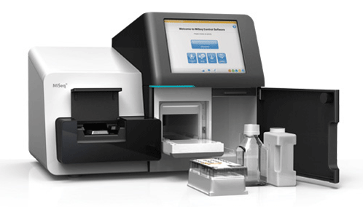
Genetic engineering techniques
Topic Question 6: Identify and describe the technique/s used by researchers to sequence genes/genomes
Method 2 – Next-generation sequencing
Millions of fragments can be synthesised simultaneously and the results automatically analysed by a computer

Slide 22
Genetic engineering techniques
Topic Question 6: Identify and describe the technique/s used by researchers to sequence genes/genomes
First – Preparation of DNA
DNA is collected (same as previous)
It is then isolated & purified
Cut into fragments of approx. 300bp in length
Fragments amplified using PCR-type method
Fragments produced are single stranded
Different types of fragments are placed into wells on a multi-well plate and barcoded

Slide 23
Genetic engineering techniques
Topic Question 6: Identify and describe the technique/s used by researchers to sequence genes/genomes
Second – Sequencing
One reaction mixture is used which contains:
DNA fragments (single stranded)
Modified versions of the four nucleotides. Terminating set of the four nucleotides which prevent elongation of the strand. Each of the four nucleotides have a different fluorescent tag attached
DNA polymerase
Primer
Mixture washes over the multi-well plate
DNA polymerase synthesis the new DNA strand by adds the nucleotides complementary to the template strand

Slide 24
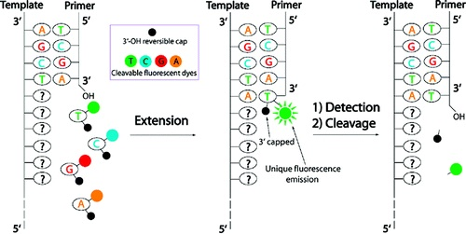
Genetic engineering techniques
Topic Question 6: Identify and describe the technique/s used by researchers to sequence genes/genomes
Each time a chemically tagged terminating nucleotide attaches to the template strand, there is a flash of light & this is recorded
A different colour of light flashes for each different type of nucleotide added
Notes:
Each incorporated nucleotide is identified by its different colored fluorescent tag

Slide 25
Genetic engineering techniques
Topic Question 6: Identify and describe the technique/s used by researchers to sequence genes/genomes
Third – Data Analysis
The recorded light flashes reveal the sequence of nucleotides of the template strand in each well
Sequencing software identifies the nucleotides in the order of the colours recorded

Slide 26
Genetic engineering techniques
Topic Question 7: Describe the applications of DNA Sequencing ​
The genomes of thousands of species have been sequenced
Allows for comparison of genomes and genes between species
This allows scientists to investigate relatedness and evolutionary relationships between species
Knowing sequences allows Scientists to determine the genetic code of particular phenotypes
This can allow scientists to identify genes that may have a survival benefit in our changing environment
Example: drought resistant or salt resistant genes in plants to be used in recombinant DNA technolopgy
Gene sequencing for identification of disease
Facial tumours of Tasmanian Devils
Ecosystem sequencing
Sampling a litre of sea water can show what organisms are living in the area
Notes:
Allows for gene mapping – identifying and recording the positions or relative locations (locus) of genes, the distance between genes on a chromosome
When a species genome is mapped – all chromosomes in a somatic cell are mapped

